Slide 1














AWS Security Monitoring
Security Account
TNC Account
Logging Account
AWS CloudTrail
AWS Config
Logging Archive
S3://App/Account#
Amazon GuardDuty
Core Account
S3://App/Account#
SQS
Subscribes to SNS Topic
Splunk Heavy Forwarder EC2
AWS CloudTrail
AWS Config
Amazon GuardDuty
SNS Service
Topic on S3
App Account
AWS CloudTrail
AWS Config
Splunk Cloud ELB/ALB
AWS GuardDuty

Slide 2


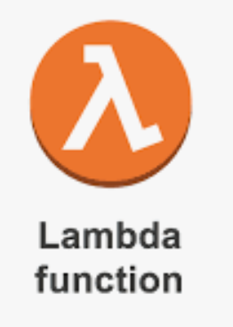
AWS Security Monitoring
Splunk Cloud ELB/ALB
Security Account
TNC Account
Logging Account
US-WEST-2
AWS CloudTrail
AWS Config
Logging Archive
Splunk Heavy Forwarder EC2
S3://App/Account#
Amazon GuardDuty
Ec2 –status change
Core Account
SQS
Subscribes to SNS Topic
Lambda invoke
Ec2 turn on function
S3://App/Account#
AWS CloudTrail
AWS Config
Ec2 turn off function
Amazon GuardDuty
US-EAST-1
Logging Account
SNS Service
Topic on S3
App Account
AWS CloudTrail
AWS Config
SQS
Subscribes to SNS Topic
Splunk Heavy Forwarder EC2
AWS GuardDuty

